Slide 1
BOARD OF TRUSTEES ACADEMIC AFFAIRS COMMITTEE MEETING
March 25, 2021

Slide 2
Program Portfolio Review Processes
Dean-lead review of staffing and enrollment brings forward voluntary eliminations of programs
Profitability Analysis (Financial Affairs), Market Demand (Enrollment Management/External Partners), Academic Quality and Mission Fit (Standing Committee on Academic Planning)

Slide 3
Program Elimination- Studio Art

Slide 5
Program Elimination- Nurse Education (MSN)

Slide 6
Other Programs Eliminated or Streamlined This Year
- EMS Management (approved but never implemented, reassessed market demand)
- MS Education (approved but never implemented, focus on MAT instead)
- BS in Computational Math (no enrollment, focus on Computer Science instead)

Slide 7
Program Eliminations-Fall 2017-2021
Certificate in Translation and Interpretation
Concentration in Translation and Interpretation within Spanish major
BA Classical Studies with a focus on Classical Civilizations and Greek
-Bachelor of Music Education, Vocal with General Music track
(on ground) Bachelors of Criminal Justice (online remains)
Interdisciplinary minor in film
Minors in Music Industry
BA in Food Studies
(on ground) BA in Interdisciplinary Studies (online remains)
(online) BBA in Finance (on ground remains)
Sociology department moved from three concentration areas to single degree

Slide 8
NEW PROGRAMS
Already in place for fall 2021
Public Health
Pre-licensure program in Nursing
In development
MS in Health Care Administration-Fall 2022
DNP-Nurse Anesthetics –Fall 2023

Slide 9
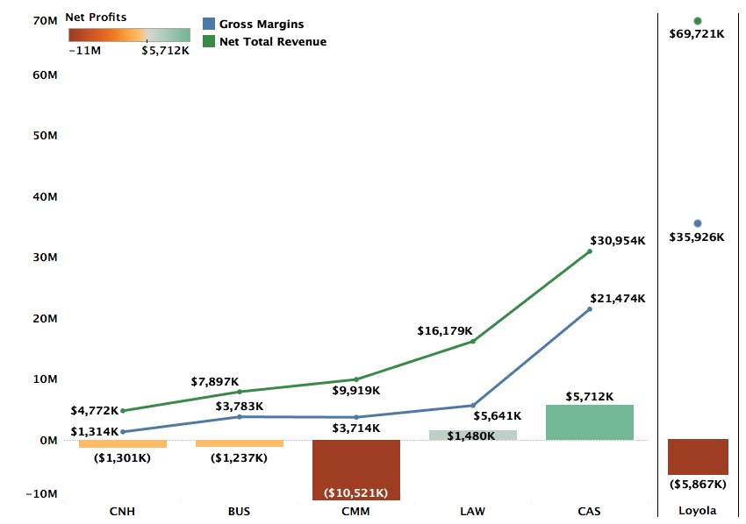

Profitability by College FY21 Projections

Slide 10
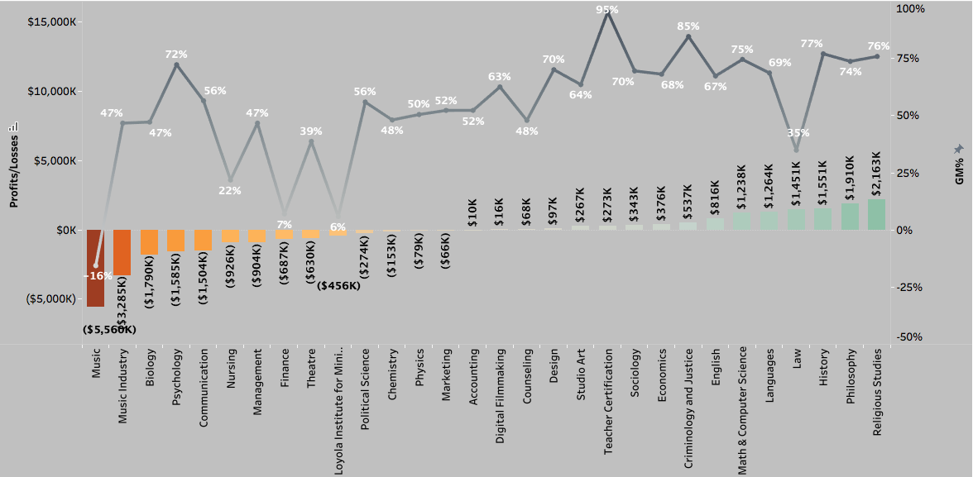
Profitability and GM% by Department (FY21 Projections)

Slide 11
Definitions
Total Revenue (TR): TR includes revenue for courses taught by the faculty of a department across all three terms, distributed revenue for courses that do not belong to a specific department, and distribution of revenues from courses of programs like Study Abroad that do not have any assigned faculty.
Avg. TR per credit (FY20) for Fall and Spring semesters is $577
Gross Margins (GM): GM = TR – Direct Costs. Direct costs include salaries, operating costs, and fringe benefits.
Avg. GM% for FY20 = 54%
Profitability = GM – Indirect Costs + Indirect Revenues. Indirect costs refer to administration costs, auxiliary costs, or college level costs distributed over departments of the specific college. Indirect revenues include auxiliary revenues, dorm revenues, and revenue from other sources.

Slide 12
Methodology FY21 Projections
FY21 Revenue Projections: Revenue projections are based on Fall 2020 enrollments and projected Spring retention rate. FY20 summer revenues are used as proxy for the FY21 summer term.
Direct Costs: Direct costs include salaries and operating costs from department budgets. FY20 fringe benefits are used as a proxy for FY21 fringe benefits.
Indirect Costs: Indirect costs in FY20 and FY21 have been higher than previous years and is reflected in department-level profitability. FY21 is also estimated to bring in lower Auxiliary revenues.

Slide 13
FY21 Discount Rates by Department (Excl Law, Nursing)

Slide 14
At-Risk Departments – Total Revenue & Credits (FY20)

Slide 15
Departments with Worsening Financial Performance

Slide 16
Music
Music has high enrollment but also a historically high discount rate which suppresses their TR.
Music also has twice the directs costs of an average department which further suppresses their GM% to -18% (FY20) and -16% (FY21).
GM% for Music was negative in FY20 due to a steep decline in TR without proportional cuts in direct costs. The steep decline in TR was driven by high discount rate as evidenced by TR/Credit of $387 compared to university average of $577 and is only seeing a slight recovery in FY21.

Slide 17
Music Industry
The TR/Credit for Music Industry decreased from $698 in FY19 to $519 in FY20 signifying high discount rates as drivers of low revenues, despite increase in # credits from FY19 to FY20
The FY21 GM for Music Industry is 47% compared to the university average of 55%
Increased auxiliary costs and reduced auxiliary revenues because of COVID-19 add to the projected losses in FY21 but the structural issues of high discount rates that have driven losses historically persist

Slide 18
Nursing
Nursing continues to be an expensive program (21% GM in FY21 compared to the university average of 55%).
Gross Margins are also expected to decrease more than the projected decrease in TR (i.e., $770K versus 469K) due to increased direct costs in FY21.
Increased auxiliary costs with lower auxiliary revenues add to the FY20 losses and the projected losses for FY21.

Slide 19
Theatre
The projected GM for Theatre is 39%, 15 percentage points lower than the university average
Theatre’s low GM is being driven by high discount rates. TR/Credit of $471 in FY19 and $425 in FY20 compared to the university average of $594 and $577 in both years respectively
Projected increases in auxiliary costs and simultaneously declining auxiliary revenues because of COVID-19 add to the department’s losses

Slide 20
Psychology
Although Psychology has low direct costs yielding it a 72% GM, it struggles with profitability primarily due the high level of indirect costs that are allocated to the department based on student enrollment.
Their TR/Credit is only $516 in FY19 and $509 in FY20 compared to the university average of $594 and $577 in both years respectively.

Slide 21
Biology
With slightly increasing TR and GM, the increase in projected losses for FY21 are driven by higher auxiliary costs and lower auxiliary revenues.
However, the structural problems of high discount rates from FY19 remain as its 47% GM fails to cover its share of overhead.
Their TR/Credit is only $491 in FY19 and $462 in FY20 compared to the university average of $594 and $577 in both years respectively.

Slide 22
Communication
Communication had an a slight increase in TR from FY19 to FY20 but is projected to see a ~11% decline in FY21 due to lower enrollment
GM of 56% is only slightly higher than the avg of 54%, but is weighed down by indirect costs given the department’s size

Slide 23
Finance
Finance had a steep decline in TR in FY20 leading to a big drop in GM from 39% in FY19 to 7% in FY21 due to the largely fixed nature of its direct costs.
Their TR/Credit declined from $619 in FY19 to $475 in FY20. Without a significant change in # credits taken, the TR decline is primarily driven by high discount rates. As such, the strategy to increase enrollments with higher discounts has not paid dividends.

Slide 24
Departments with Improving Financial Performance

Slide 25
Chemistry
After a drop in GM in FY20, Chemistry’s GM is projected to improve from 35% in FY20 to 48% in FY21 due to higher enrollment better countering its higher fixed direct costs.
However, university-wide structural issues pertaining to high discount rates remain a challenge to achieving profitability.

Slide 26
Political Science
GM has improved from 50% in FY20 to 56% in FY21 driven mainly by higher enrollment and revenues as direct costs have stayed largely constant.
Structural issues with high discount rates across the university continue to ail the department. Lower discount rates will help the department pull in revenue proportionate with its size in terms of enrollment.

Slide 27
Management
Management’s TR has seen an increase from FY19 to FY21’s projection, with fluctuations in profitability primarily driven by changes in Gross Margins each year.
The TR/Credit for Management decreased from $544 in FY19 to $528 in FY20 signifying higher than average discount rates

Slide 28
Marketing
A healthy enrollment-driven projected increase in TR for Marketing is likely to reduce the losses for the department to $60K in FY21.
Steeper discount rates seem to correlate with this increase in TR. TR/Credit = $569 in FY19 and $525 in FY20, while # credits increased from 2040 to 2316. This growth will have to be balanced with lower discount rates.

Slide 29
Loyola Institute for Ministry
Lim is projected to yield a 6% GM in FY21 compared to the university average of 54%.
With $491K direct costs, there is a need for much greater enrollment as # credits in LIM declined from 1401 (FY19) to 1287 (FY20)
LIM’s TR of $378 is far below the university average of 577.
So it’s a combination of high discount rates and low enrollments that’s driving losses

Slide 30
Summary and Recommendations
Higher indirect costs and lower auxiliary revenues because of coronavirus crisis are reflected in losses of all departments.
Outside of the increased auxiliary costs, loss-making departments suffer from performance issues of lower enrollment and structural issues of high direct costs and high discount rates
High discount rates reflect the discounts offered to students taking courses offered by specific departments. These students may or may not be part of the majors offered by the departments. As such, driving lower discount rates should be a university wide initiative.

Slide 31
Summary and Recommendations
For departments with declining enrollment, a separate analysis to identify the majors driving lower enrollment can be provided at a later date.
Additional analysis that can benchmark proportionate direct costs in relation to enrollment in each department can help improve the GM to Revenue Ratio.
Finally, improvement in auxiliary revenues and reduction in auxiliary costs post-coronavirus will aid the university-wide profitability.

Slide 32
Appendix (FY19 and FY20)

Slide 33
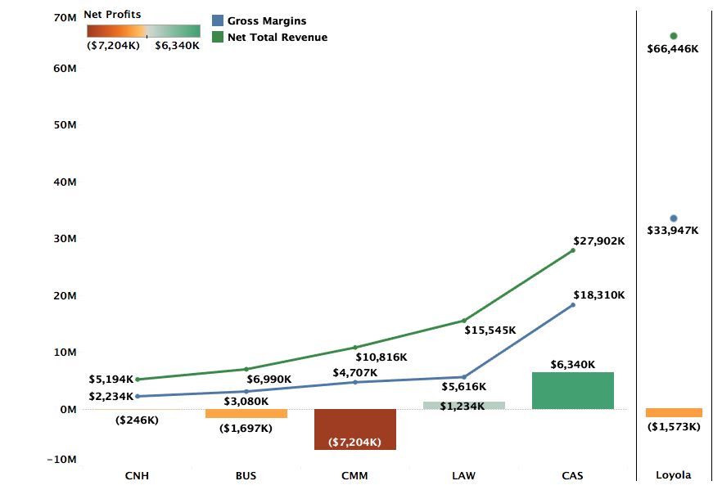
Profitability by College FY20 Actuals

Slide 34
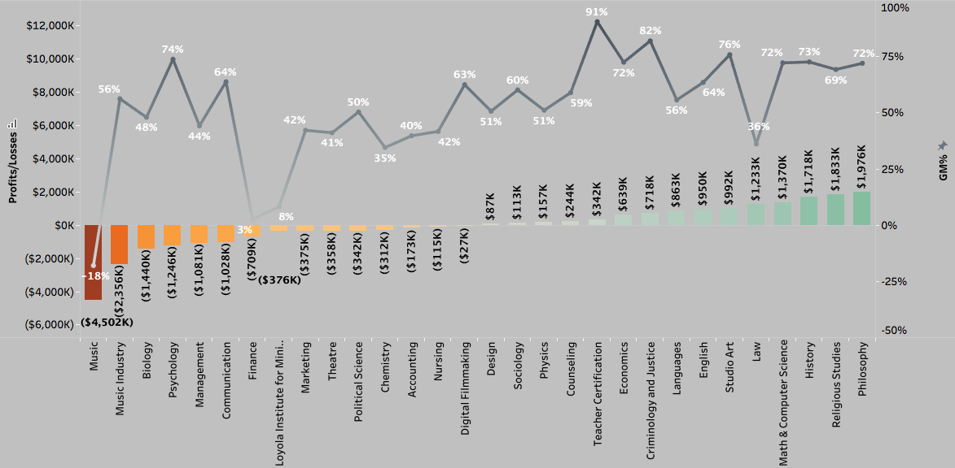
Profitability and GM% by Department (FY20 Actuals)

Slide 35
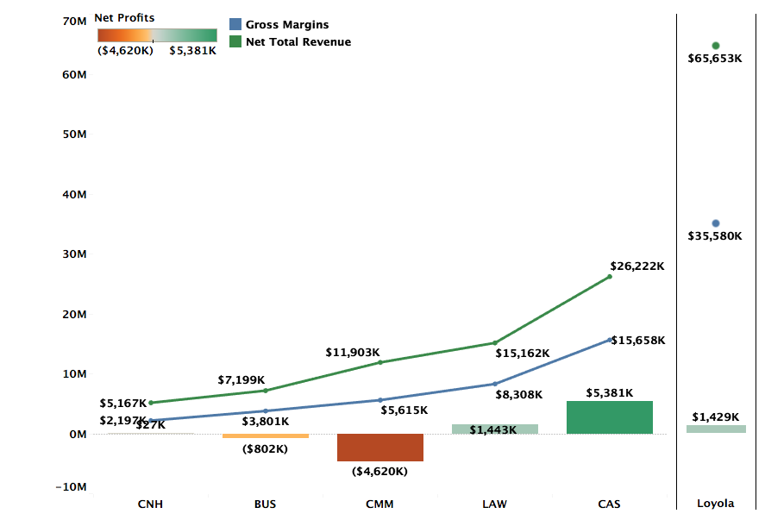
Profitability by College FY19 Actuals

Slide 36
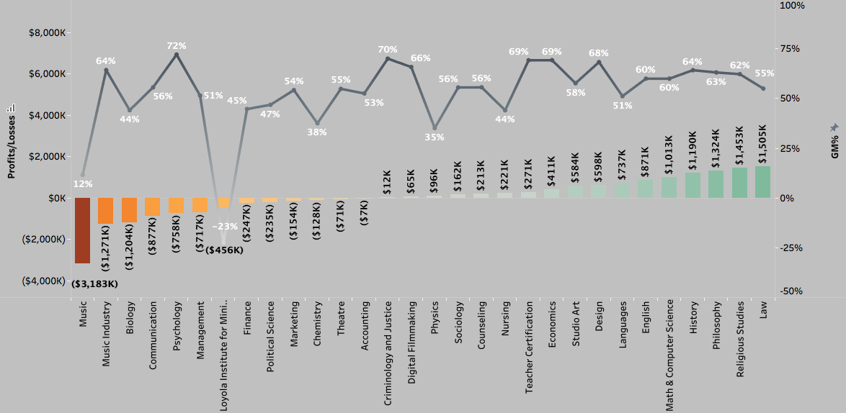
Profitability and GM% by Department (FY19 Actuals)

Slide 38
Notes for Slide 37:
1. This only captures the fall and spring revenue and not the summer revenue for FY20.
2. The revenue is calculated for all the students enrolled in majors sponsored by these departments. But these students can be taking courses outside of the department.
3. In light of the above two points, this chart should only be used to estimate the loss in tuition revenue if any of these departments are being considered for elimination.
4. Because of the inherent complications in calculating revenues rolled up by faculty, any comparisons with revenue figures in the previous slides are likely to be inaccurate.
5. However, since the revenues are from FY20 and not FY21 where enrollment was hit by COVID-19, these revenue numbers should be a good estimate for FY21 if we are able to recapture the enrollment for FY20. However
6. In comparison to slide 14, the following deductions can be made (even though slide 14 captures summer revenue that slide 37 doesn’t)
a) Students with communication major tend to take a lot of courses outside the department. Since this is also the largest department under consideration, a big portion of the revenue from students with communications major goes to departments that teach compulsory courses.
b) However, the revenue differential isn’t merely about the compulsory courses. As such the variety/quality/convenience of course offerings by communications department should be investigated.
c) Again comparing with slide 14, not a considerable difference for Music. This means that music major students take most of their courses in
Music. But given Music’s revenue per student is second lowest, its quite clear that the department is not pulling its weight towards revenue.
d) Nursing has the worst revenue per student and comparing its size (in terms of #students) to Communication, it should ideally be accounting for nearly double the revenue. It is also projected to see one of the worst declines across all departments for FY21 (slide 18).
e) Music Industry has the second highest average revenue per student among the 8 departments. But since this is the group of the worst performing departments, that is not necessarily an advantage. The department’s students also seem to be taking more classes outside their department, compared to music, but at a much lower scale than Communication.
f) The rest of the departments have similar trends – students take courses outside of their departments, discount rates are higher as evidenced by their low revenue/student, and while Psychology and Biology have more than $2mn in revenue and over 200 students each, Finance and Theater have less than 100 students and approx. $1mn in revenues.

